Slide 1
Interpretability and Explainability
Introduction to Deep Learning: Class 3.2

Slide 2
Module Agenda
Experiment Tracking (Lecture 3.1)
Monitoring/Observability (Lecture 3.1)
Explaining model predictions (Lecture 3.2)
Profiling

Slide 3
Pre-read
Christoph Molnar — *Interpretable Machine Learning* (free online book): https://christophm.github.io/interpretable-ml-book/

Slide 4
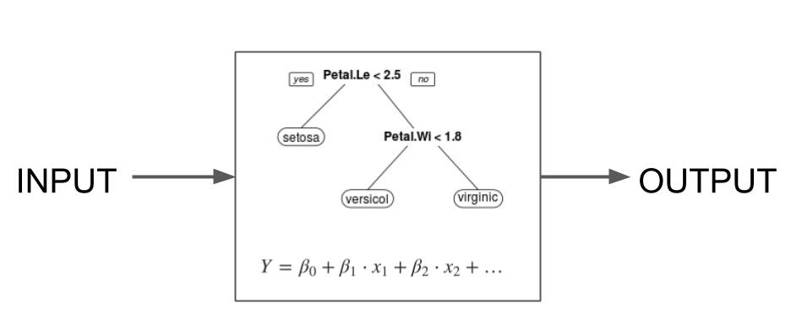
Interpretable ML Models
Why is a ML model making a certain prediction? Is it learning the right thing?
Inherently/Intrinsically Interpretable
Some models are interpretable by design. Eg., linear regression models and gradient boosted trees. Other architectures eg., neural networks require specialized methods to understand their predictions
Model specific vs. Model agnostic
Model agnostic methods treat the model as a black box and analyze how the model output changes in response to a perturbation in model input. Eg., ICE, PDP, Shap.
Model specific methods use knowledge of the model architecture. Eg., integrated gradients for neural networks
Local vs. Global
Local: Explain individual predictions
Global: How features influence predictions on average

Slide 5
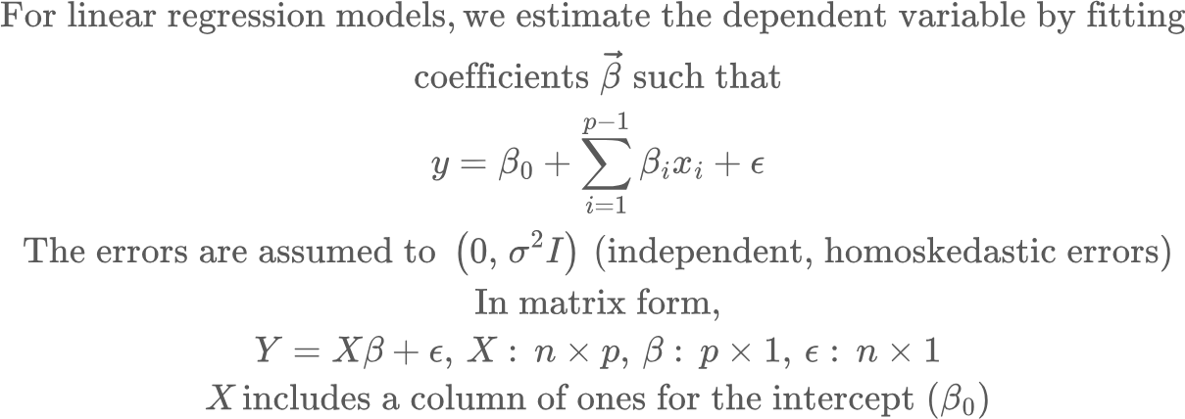
Interpretable Models: Linear Regression

Slide 6
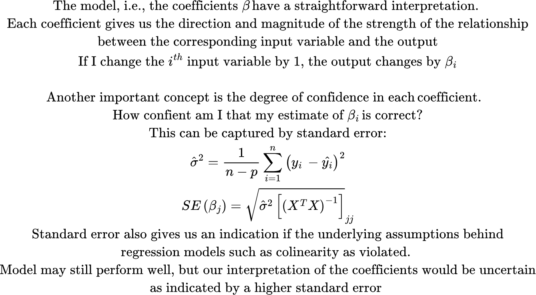
Interpretable Models: Linear Regression
linreg_collinearity_widens_ci.py

Slide 7
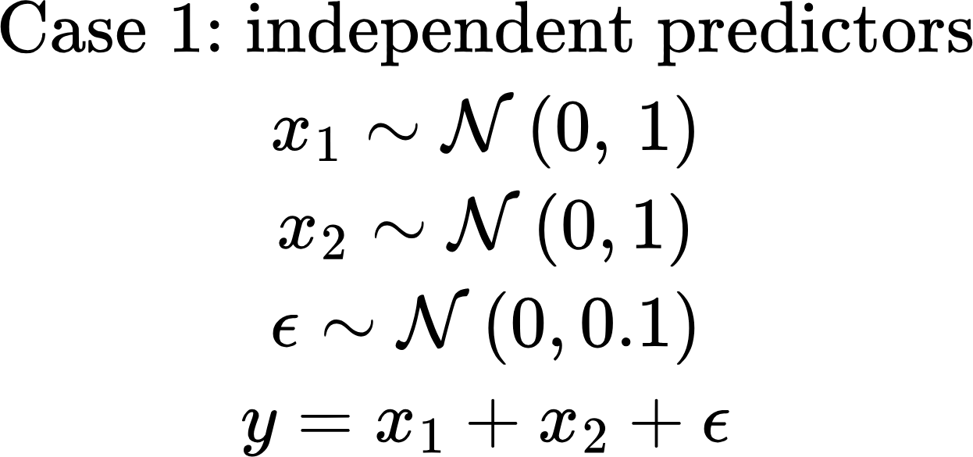
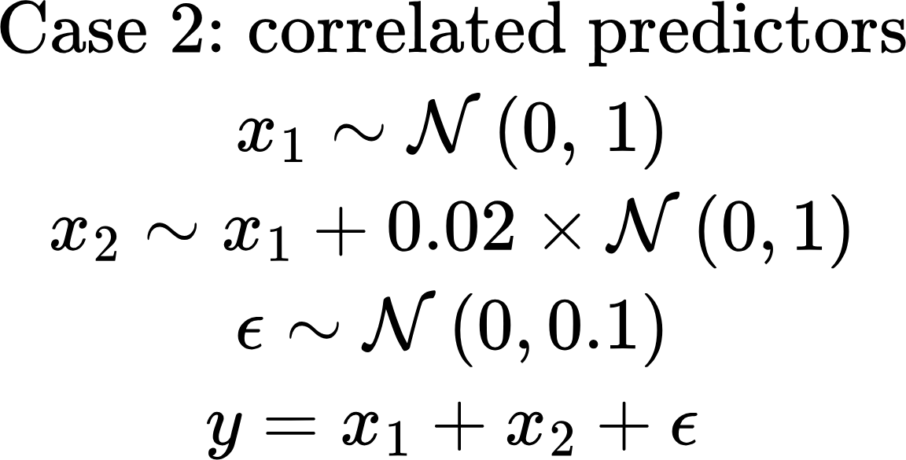
Example
=== Independent features ===
intercept: beta=-0.0266 SE= 0.0332 95% halfwidth= 0.0652
x1: beta= 1.0266 SE= 0.0333 95% halfwidth= 0.0654
x2: beta= 1.0007 SE= 0.0346 95% halfwidth= 0.0680
=== Highly correlated features ===
intercept: beta=-0.0545 SE= 0.0316 95% halfwidth= 0.0621
x1: beta= 2.3641 SE= 1.5285 95% halfwidth= 3.0019
x2: beta=-0.3668 SE= 1.5299 95% halfwidth= 3.0046
Interpretation: The model interpretability analysis output is incorrect, because the data doesn’t meet the model architecture requirements, Collinearity in this case. Other assumptions that can be broken: homoscedasticity, i.e., the typical size of the mistakes (difference between model’s predictions and actuals) are the same everywhere
linreg_collinearity_widens_ci.py

Slide 8
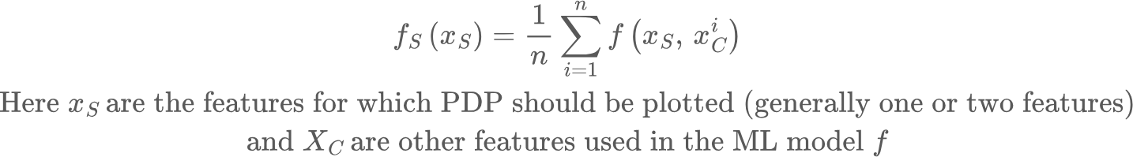
Global Model Agnostic Methods: Partial Dependence Plots
The partial dependence plot (short PDP or PD plot) shows the marginal effect one or more features have on the predicted outcome of a machine learning model (Friedman 2001). A partial dependence plot can show whether the relationship between the target and a feature is linear, monotonic, or more complex.
Unrealistic data!
x1 | x2 | x3 | f
1 | -1 | 0 | 0
3 | 3 | -5 | 1
4 | 5 | 2 | 2
6 | 6 | -1 | -1
x1 | x2 | x3 | f
1 | -1 | 0 | 0
1 | 3 | -5 | New prediction
1 | 5 | 2 | New prediction
1 | 6 | -1 | New prediction
Calculate average
PDP for x1=1

Slide 9
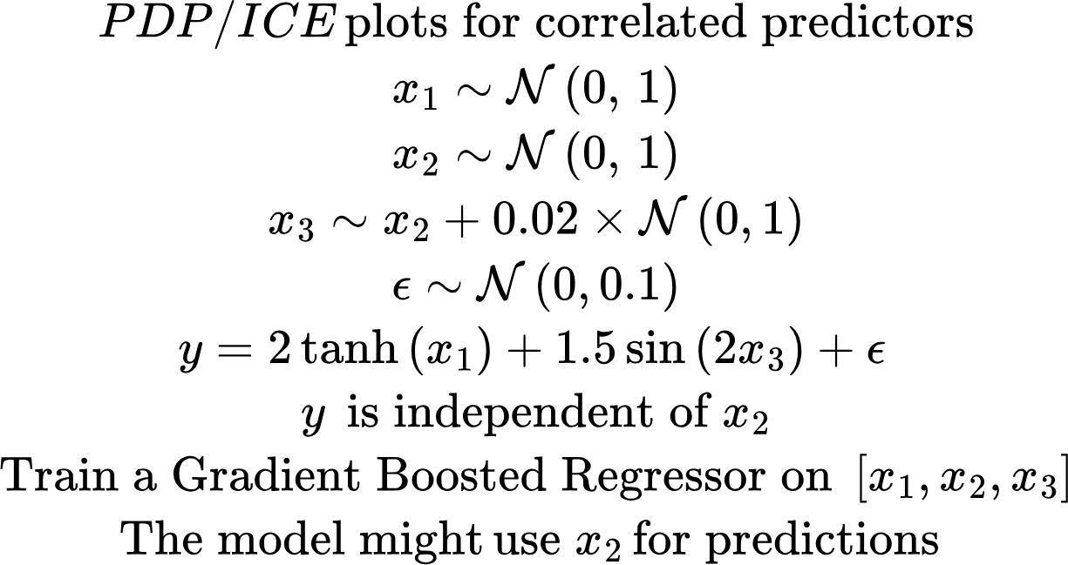
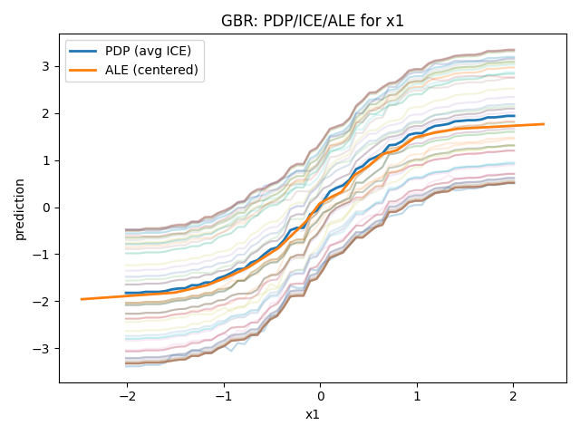
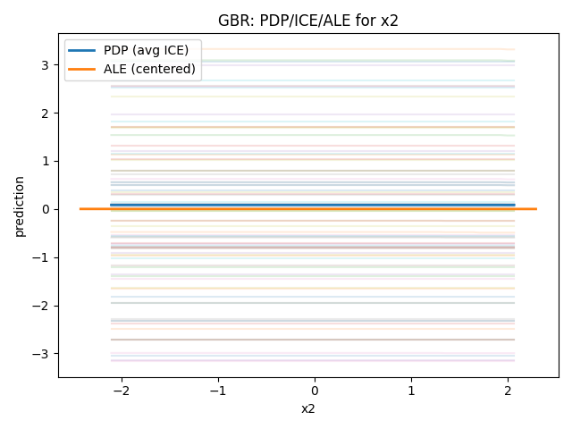
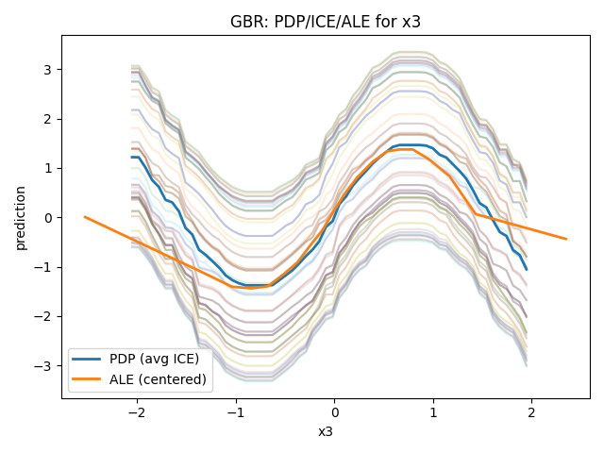
Partial Dependence Plots: Example
Procedure: Create simulated data, split into training and test subsets. Train different models on training data. Perform interpretability analysis on features of interest on the test subset using the trained models
interpretability_lab.py

Slide 10
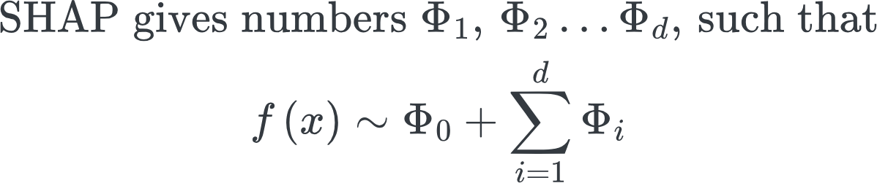
SHAP
SHAP is a way to explain a model’s prediction by answering: “How much did each feature contribute to this prediction, compared to a baseline?”
Example: Suppose a house price model predicts $600k. The average model prediction is $450k.
SHAP might say:
baseline: $450k
+$120k for neighborhood
+$40k for square footage
−$10k for age
Average prediction
ϕj​ is the average marginal change in the model prediction when you add feature j, averaged over all subsets of other features you might already have.
To decide feature j’s contribution, you consider all possible orders in which features could be “revealed” to the model.
Sometimes feature j is revealed early (when little else is known)
Sometimes late (when many other features are known)

Slide 11
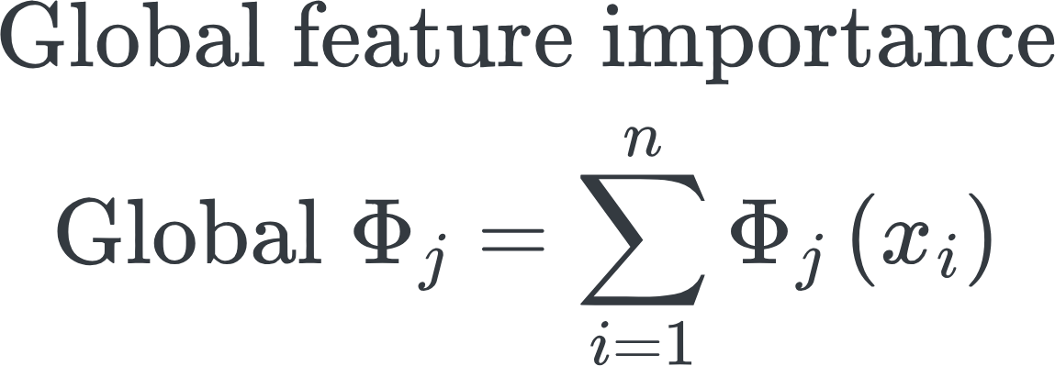
Global vs Local SHAP
Compute local SHAP values for many samples x1, x2, … xn. Now you can ask:
Which features matter most overall? Rank global SHAP scores
Do features increase or decrease predictions? Examine the relationship between SHAP scores and predictions
Are effects linear or nonlinear? Examine the relationship between SHAP scores and predictions
Are there interactions / heterogeneity? Spread in SHAP scores at the same xj indicates interactions
Key benefit of SHAP:
“Fair” credit assignment: If two features are redundant / correlated, SHAP doesn’t arbitrarily give all credit to one. It splits credit according to the Shapley fairness rules
Model agnostic: Although model-specific variants exist (Eg., TreeSHAP) that are optimized for that architecture

Slide 12
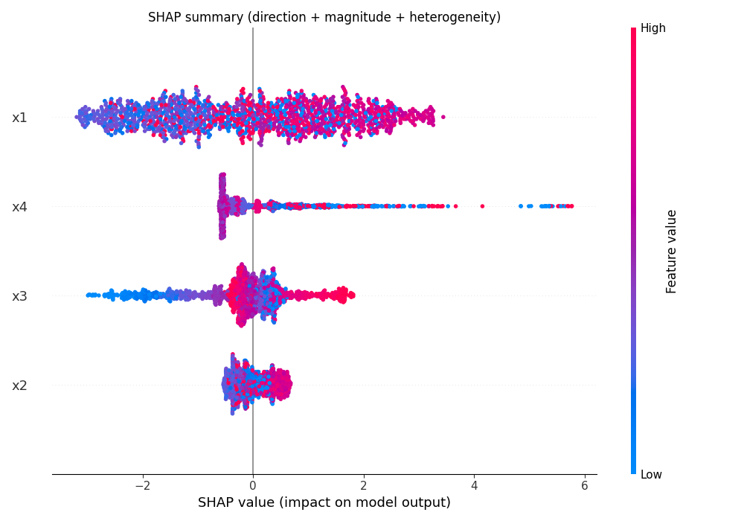
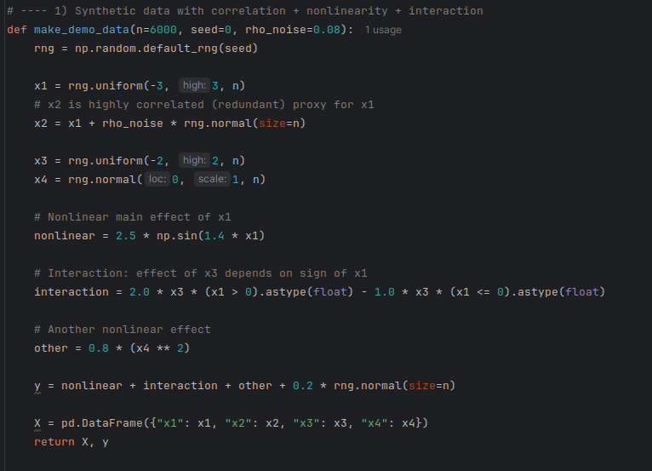
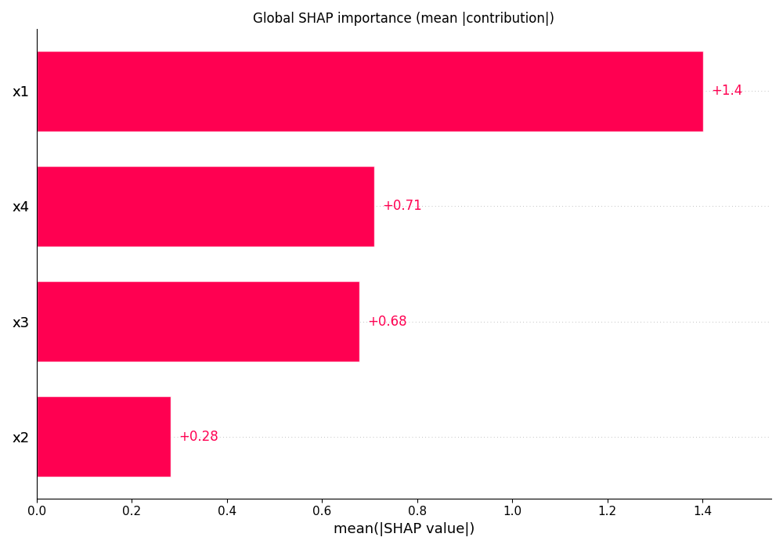
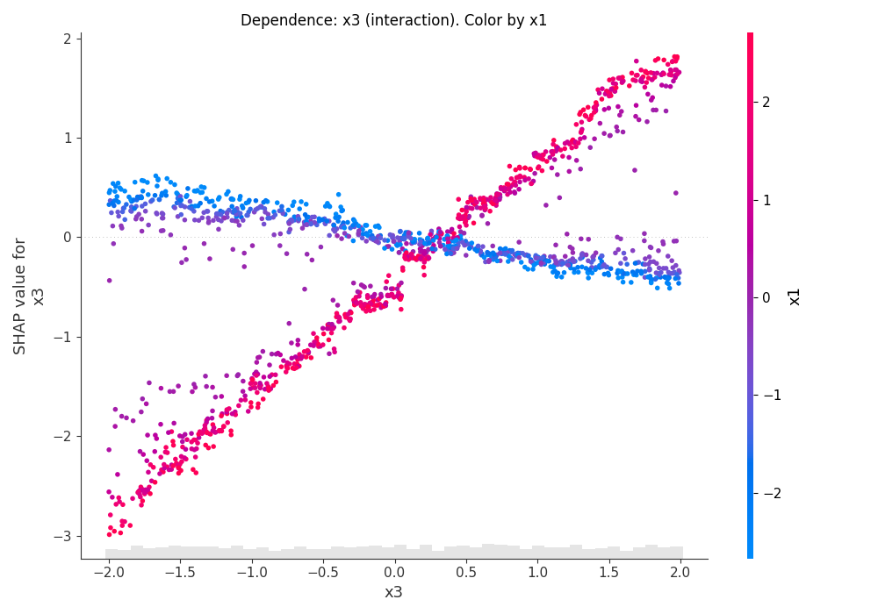
SHAP: Example
Beeswarm/summary plot
Variables are arranged on the y axis in order of importance
Shap values are on the x-axis. Positive value means that feature increased model output wrt baseline
Red/Blue values indicate high/low feature values
A red point on the left side means a high feature value decreased prediction
When x1 is high (pink points), x3 is a positive driver
When x1 is low (blue points), x3 is a negative driver
If x1 and x3 were not interacting, the blue/red points would be mixed.. Because effect of x3 wouldn’t depend on x1
Dependence Plot

